Slide 1

BIDV PROJECT
TOPIC
NETFLIX DATA ANALYSIS USING TABLEAU
By : Jatin Yadav 21BSD008
Under supervision of Dr. Priya Arora

Slide 2

Authors
What is TABLEAU?
Tableau is a leading data visualization tool used for data analysis and business intelligence. Gartner's Magic Quadrant classified Tableau as a leader for analytics and business intelligence.

Slide 3
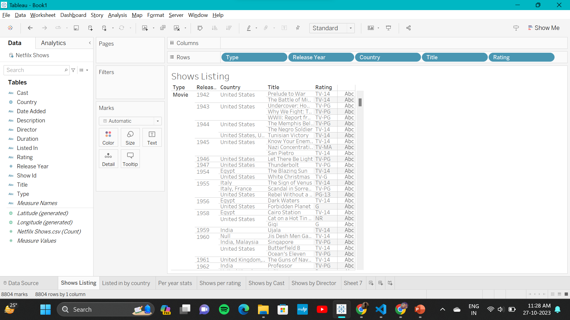
Shows Listing

Slide 4
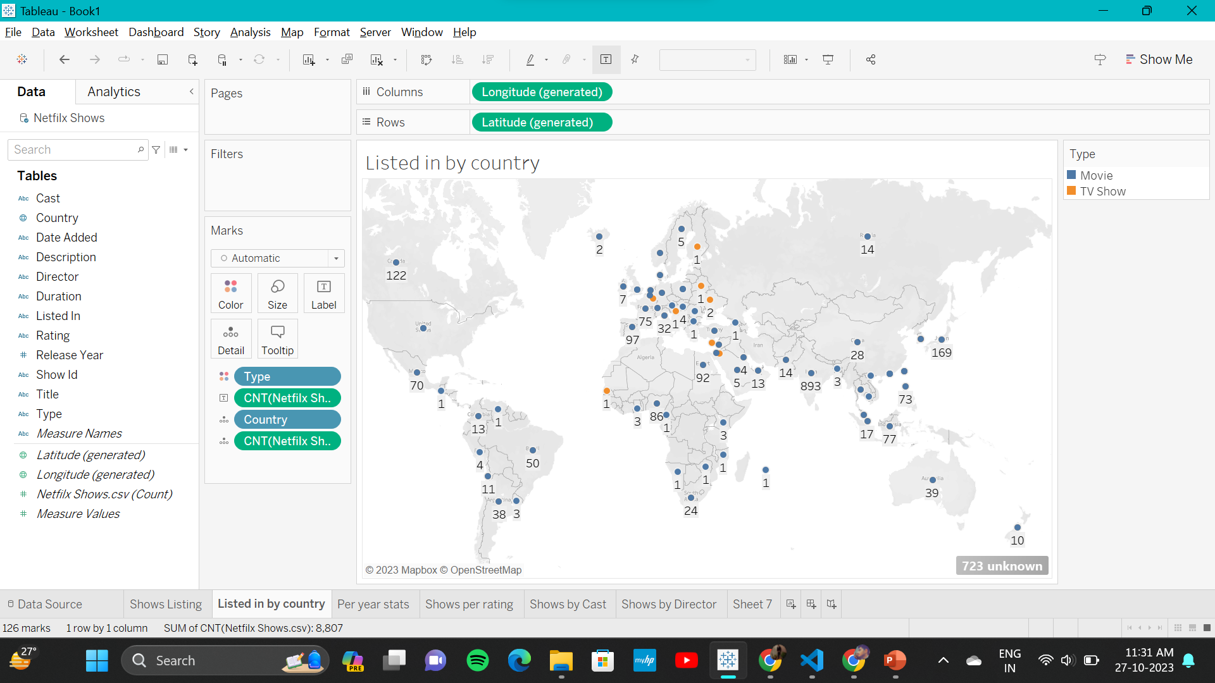
Listed in by Country

Slide 5
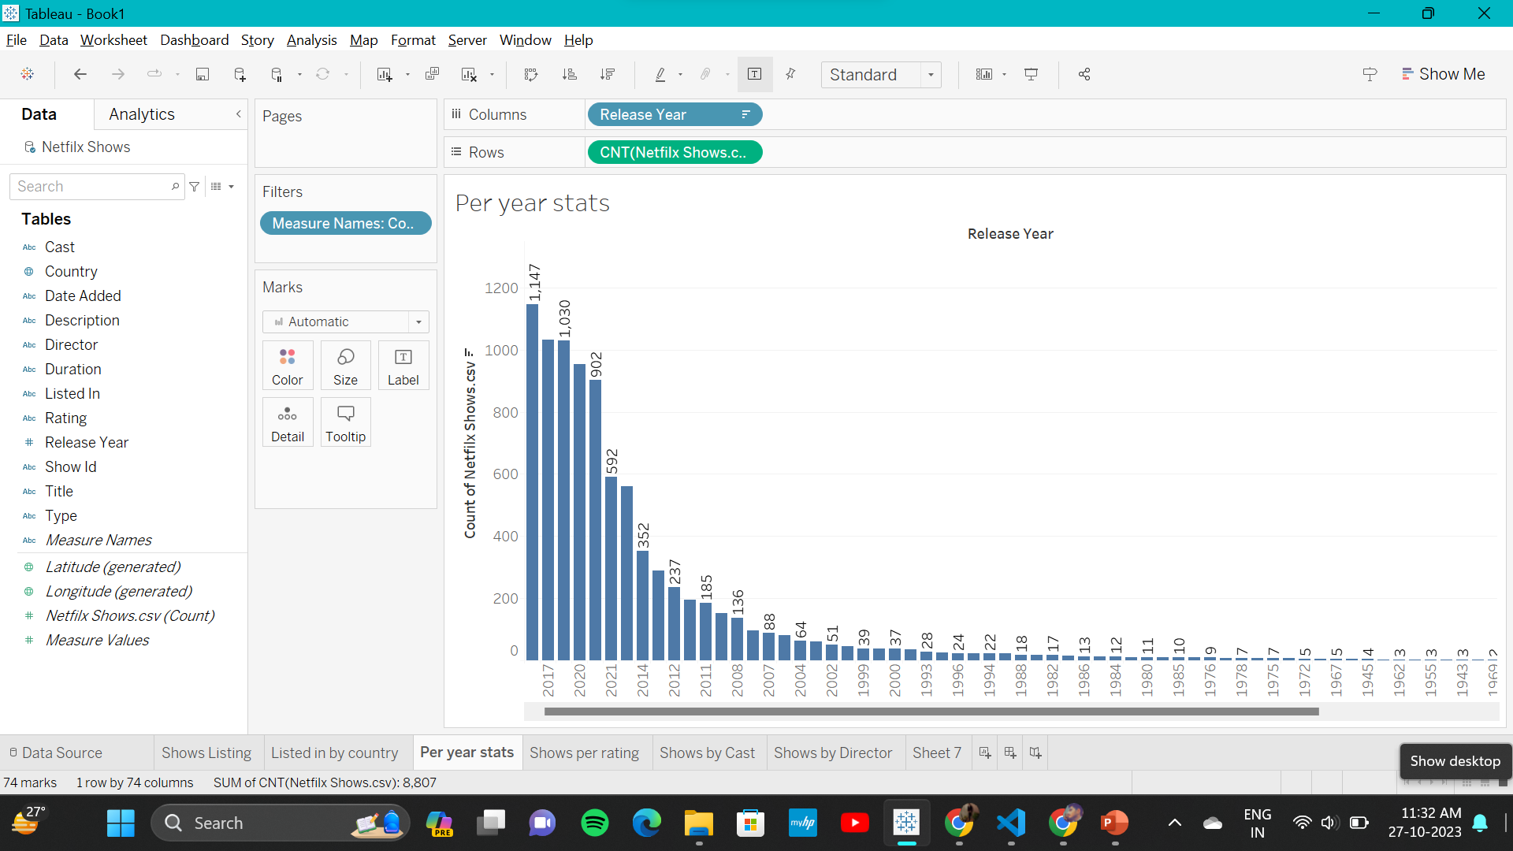
Per year stats

Slide 6
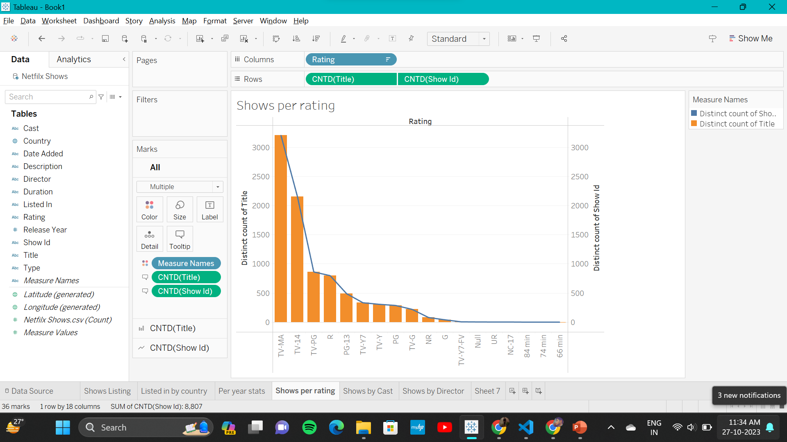
Shows per rating

Slide 7
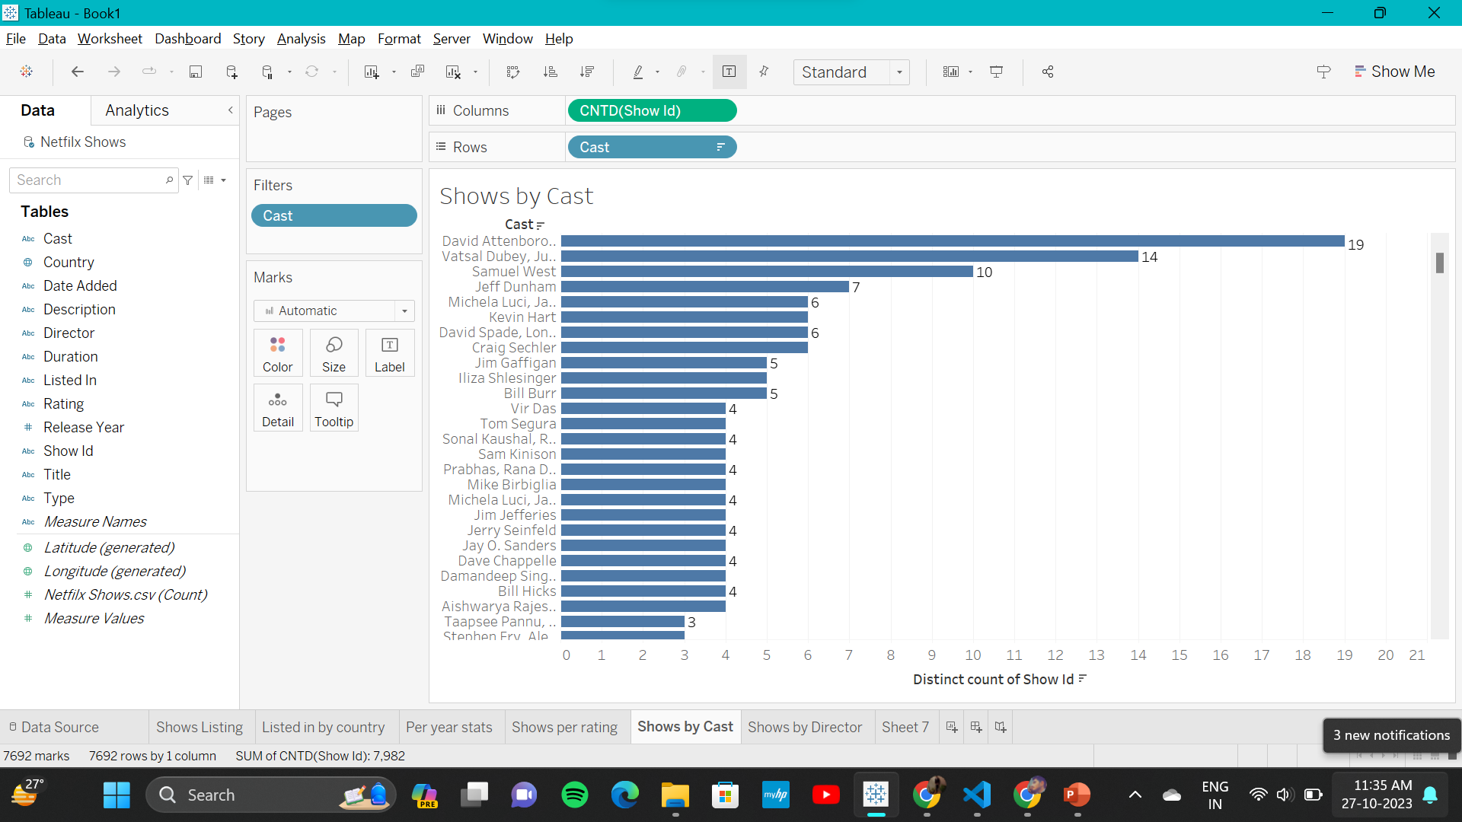
Shows by cast

Slide 8
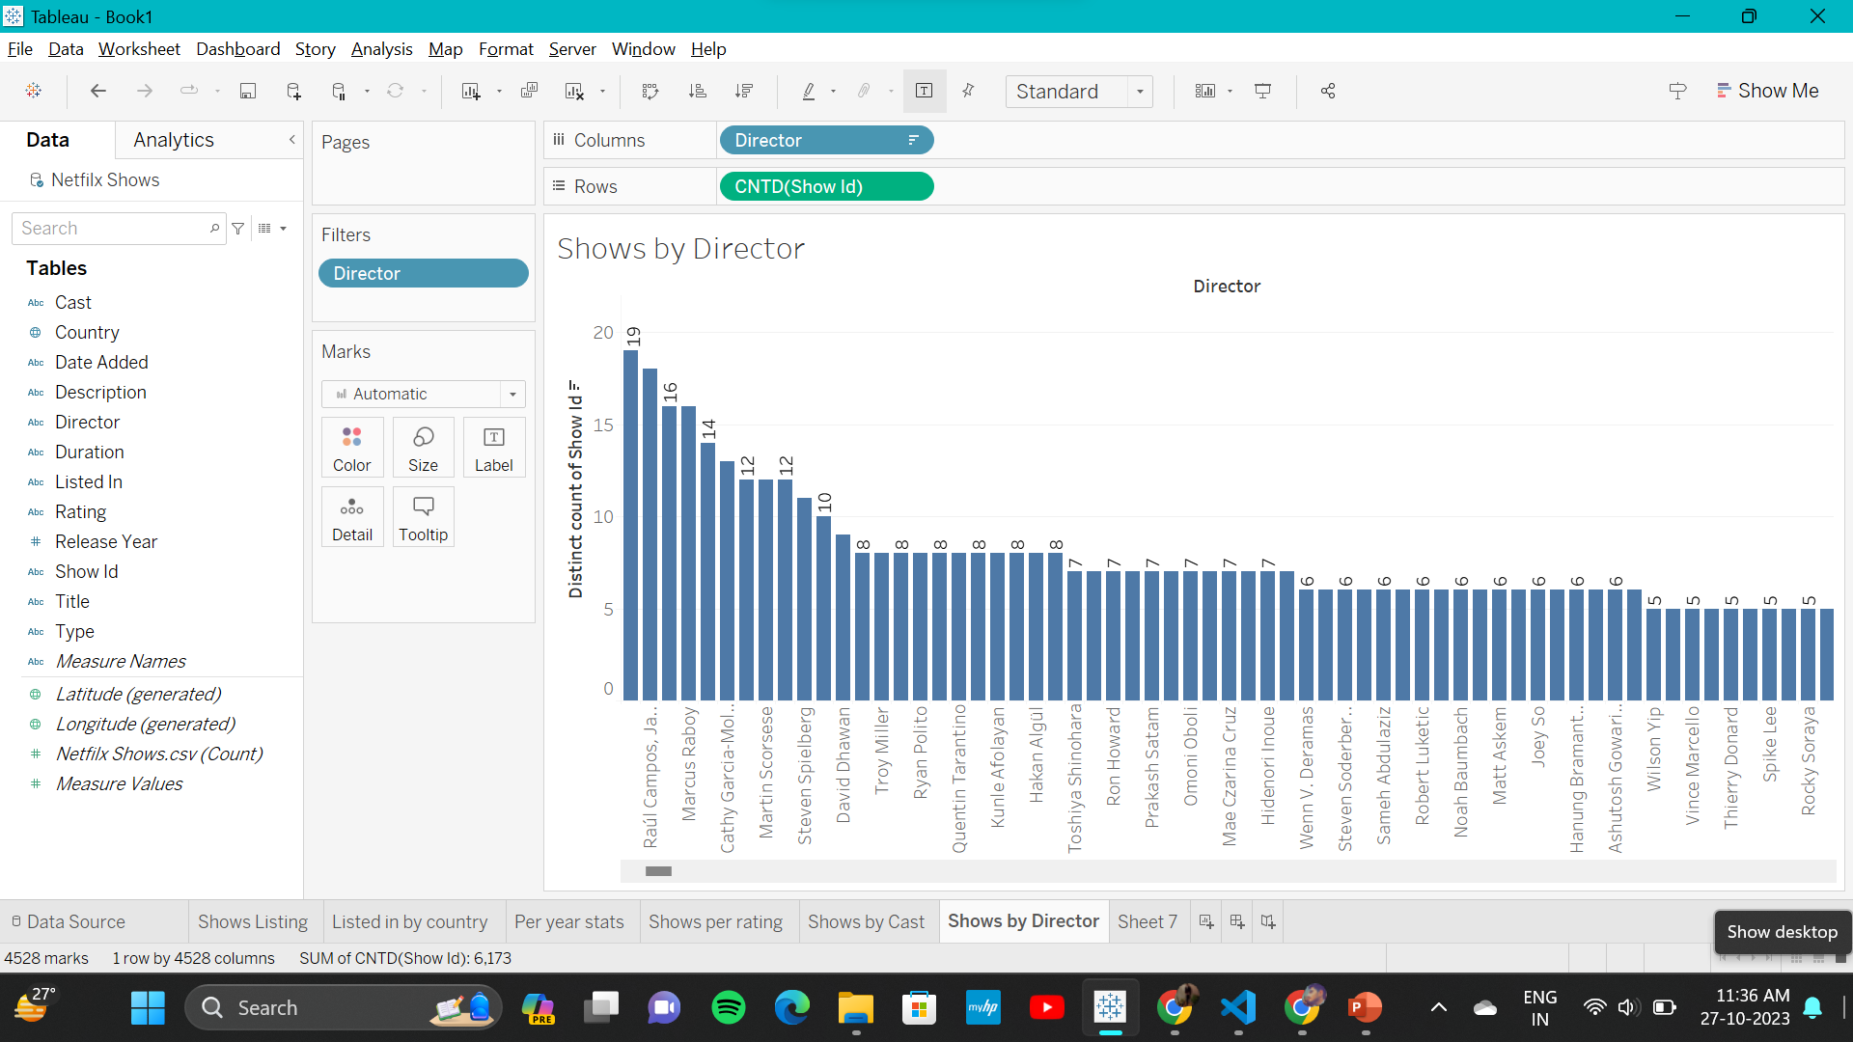
Shows by Director

Slide 9


